Slide 1
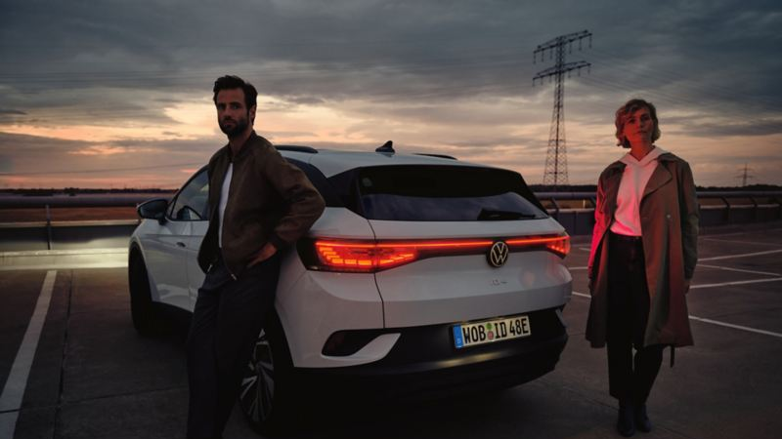



Documentation | 15 Apr 24’
ID. Series
Audience Targeting
x
15 Apr ‘24 | ID audience targeting

Slide 2
Set up

Slide 3
What do we mean by propensity?
Throughout this work we use the term propensity to denote ‘the modelled “likelihood” of a customer to purchase a vehicle from the ID series’ ¹
Past VW ownership ²
ID.4 and ID.5 RYIs ³
ID. Series propensity
EV pen. ²
x
x
=
Propensity is calculated at the postcode level – the lowest level of granularity available to us (to maximise the value of targeting) whilst leveraging free, publicly available datasets, and ensuring coverage beyond Volkswagen’s known audience.
No consideration has been made to distinguish buyers of these two EPVs
Expressed as a % of total light vehicles on the road

Slide 4
Data sources
VW Ownership
578,000 past and present owners
VGA Salesforce
% of total light vehicle owners
Electric vehicle registrations
Tesla and BYD sales in 2023
EV Council (publicly available)
% of total light vehicle owners
ID Series RYIs
5,600 ID.4 and ID.5 RYIs
VGA Salesforce (via form on website)

Slide 5
What’s changed since our PoC?
All valid EV registrations as of Jan 2023
Tesla and BYD sales in 2023
All past and present VW owners
All past and present VW owners since the start of 2017
No change ¹
Total Light Vehicle registrations as of Jan 2023
Propensity is based purely on postcode’s “likelihood”
Propensity is based on ”likelihood” and size
(1) Assumed negligible change in the Total Light Vehicles in each post code)

Slide 6
Analysis
Which cities should we focus on for launch?

Slide 7
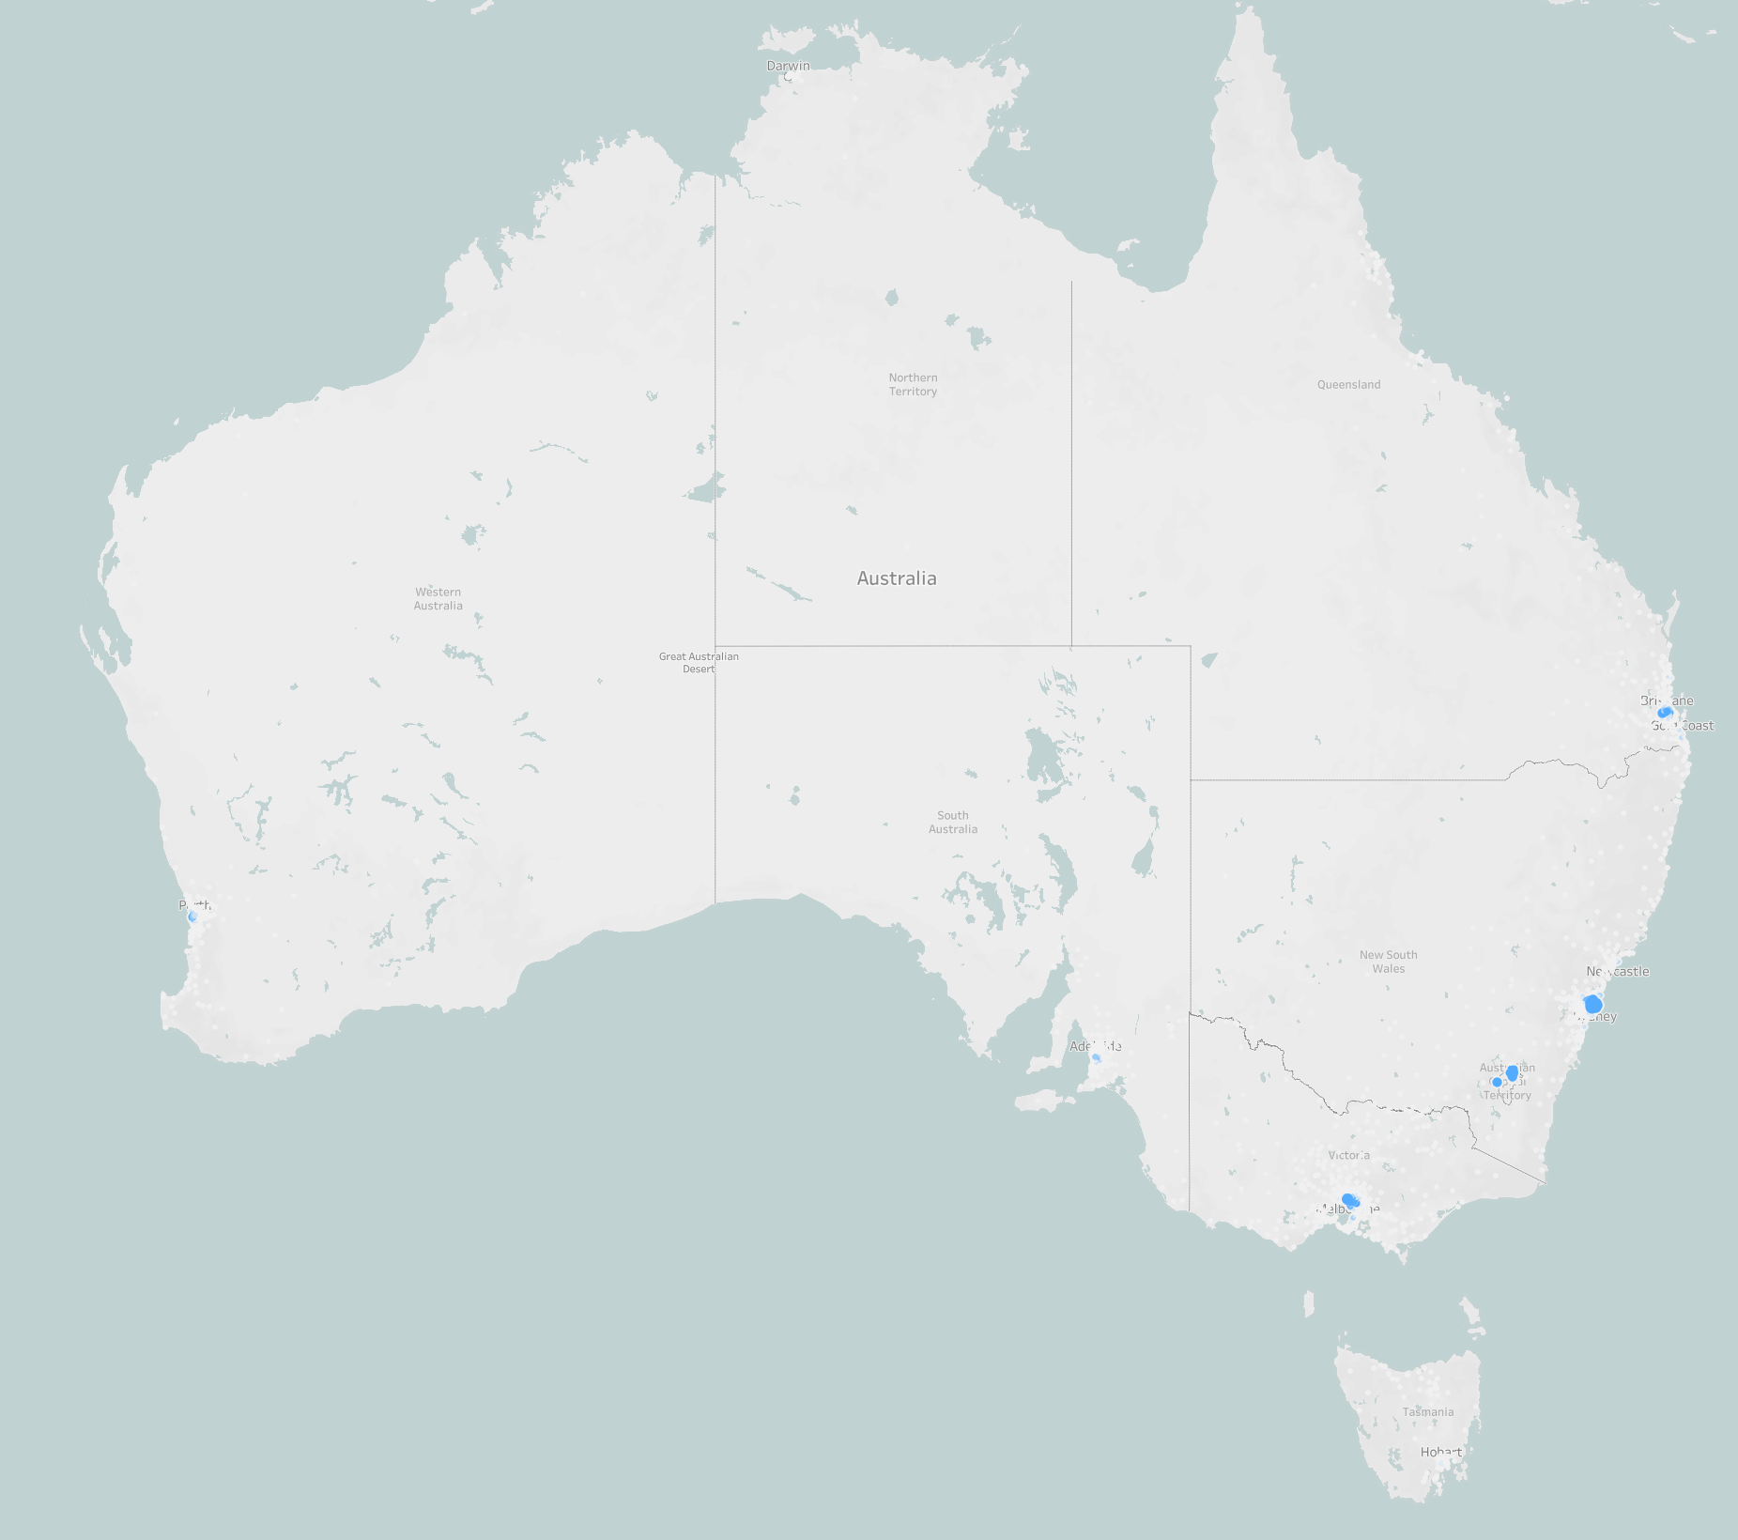
ID. Series propensity hotspots are focussed in Australia’s largest metro areas
Whilst all components of the propensity metric followed this urban centricity, it was the EV% that was most skewed towards urban areas
Double check on Tuesday

Slide 8
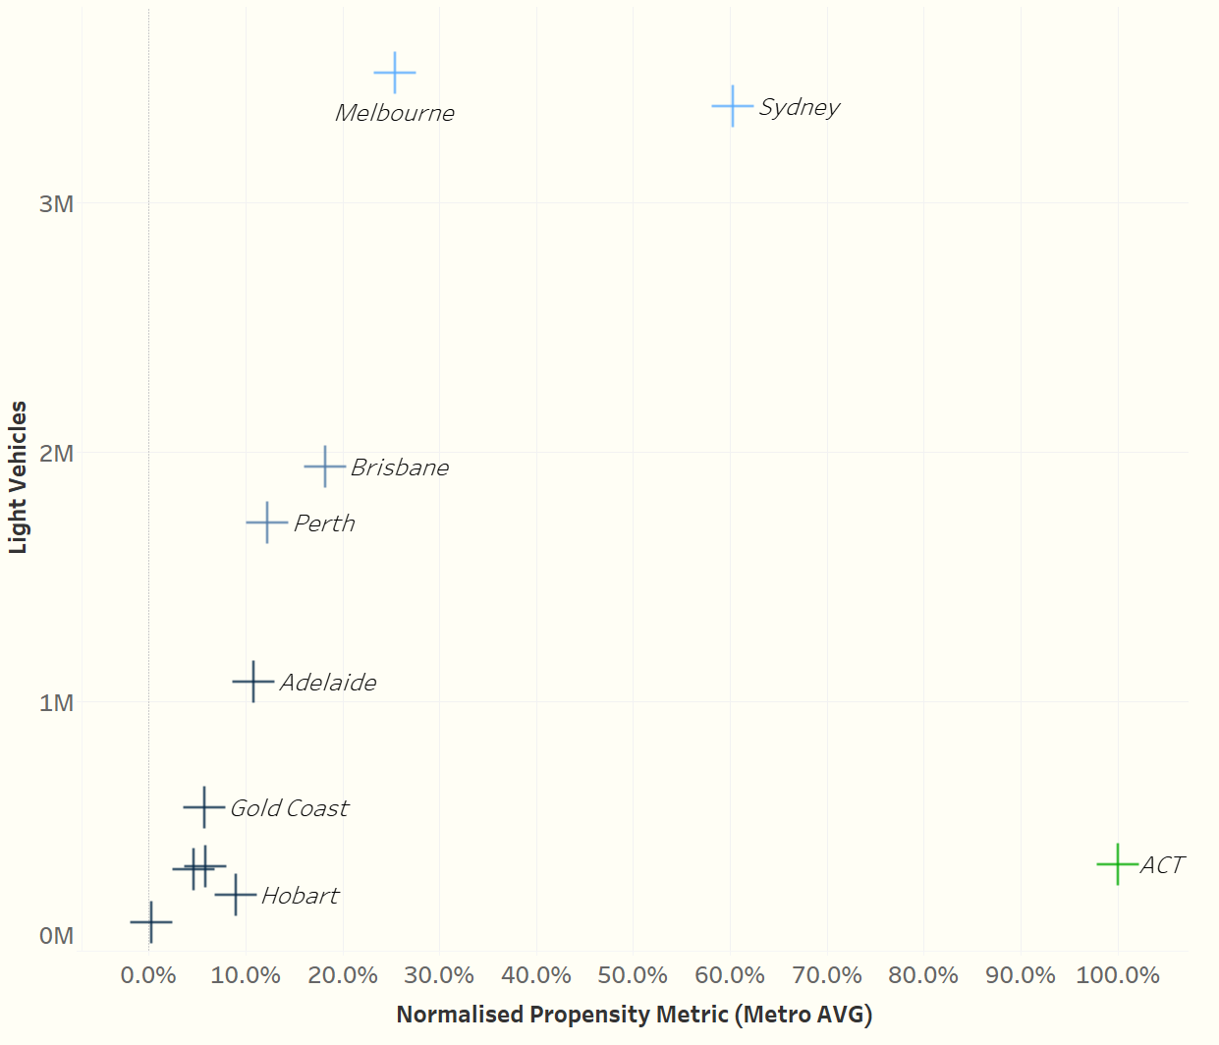
Sydney, Melbourne and Canberra represent the markets with the most significant opportunity
Canberra has by far the largest very high EV affinity though opportunity is constrained by market size.
Sydney and Melbourne are the largest urban centres, and Sydney had the second highest average propensity towards the ID. Series.
Brisbane and Perth would be the ‘next best’ cities in terms of both propensity and addressable audience.

Slide 9
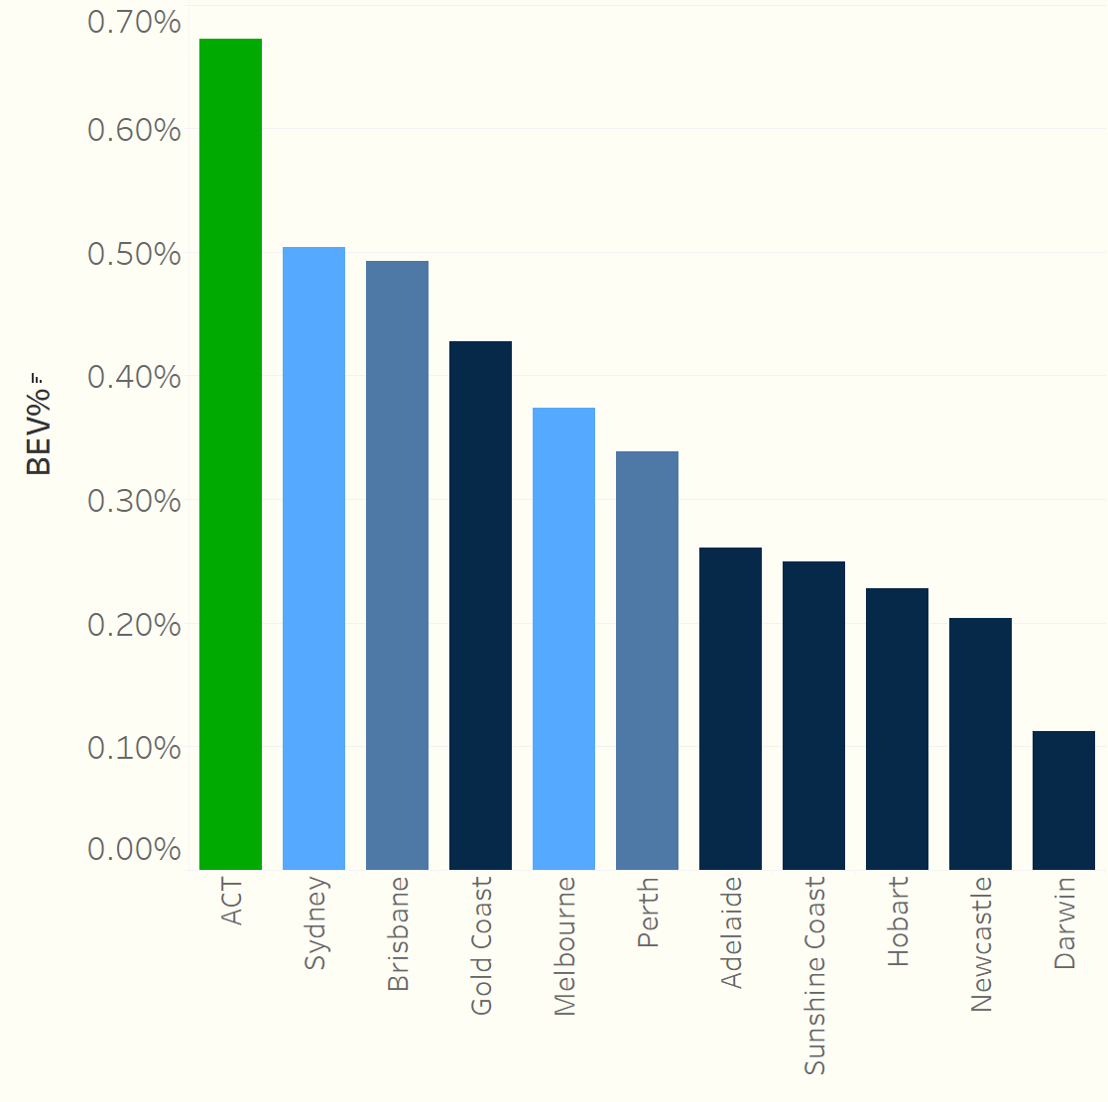
EV penetration: Most of the smaller cities lag behind in terms of their pace of electrification
Canberra led the way in terms of EV uptake in 2023, with Sydney and Brisbane leading the larger cities
Melbourne and Perth demonstrated a slower pace of electrification, but outperformed smaller cities like Hobart and Darwin

Slide 10
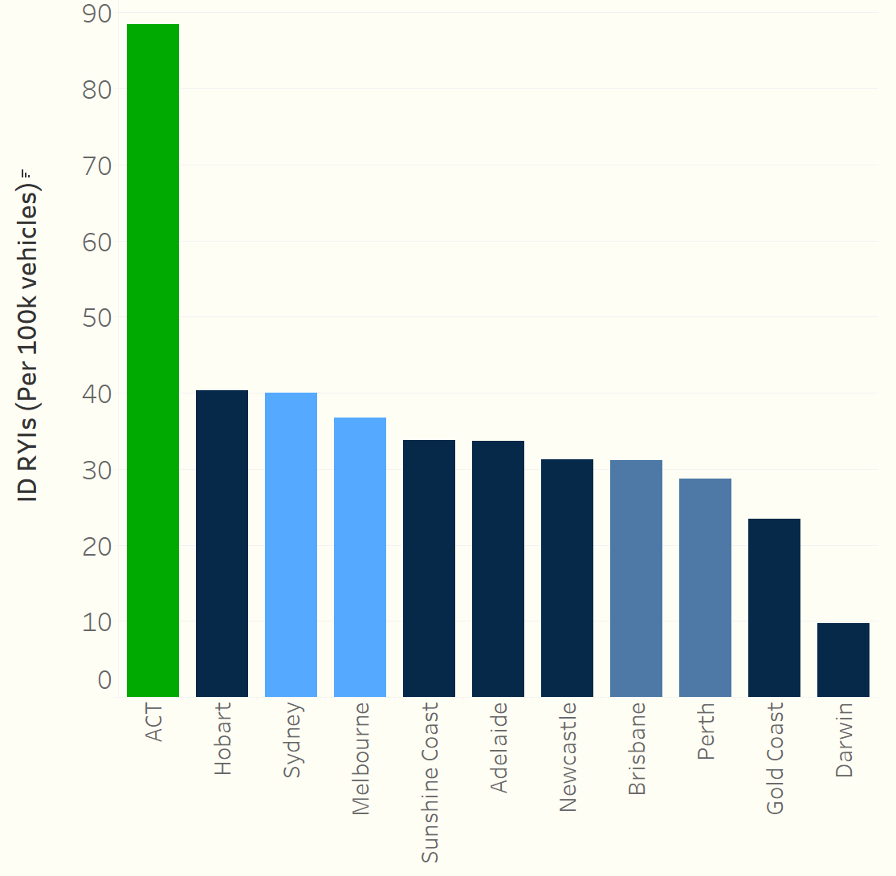
RYIs: ID. series RYI density in Canberra was more than twice that of the next city
Brisbane, Perth and the Gold Coast had relatively lower interest in the ID. series
High interest density in Hobart might be explained by the sensitivity of the metric in the case of the smaller cities

Slide 11
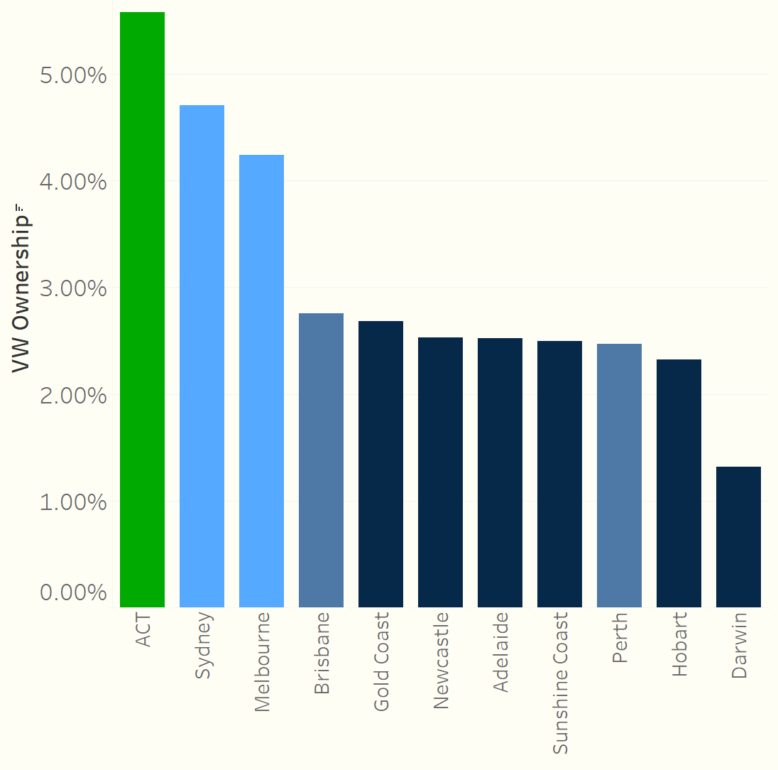
VW Owners: Canberra, Sydney and Melbourne showed much higher density of past/present VW ownership
Again Canberra has a higher rate of VW ownership vs the other
Melbourne and Perth demonstrated a slower pace of electrification, but outperformed smaller cities like Hobart and Darwin

Slide 12
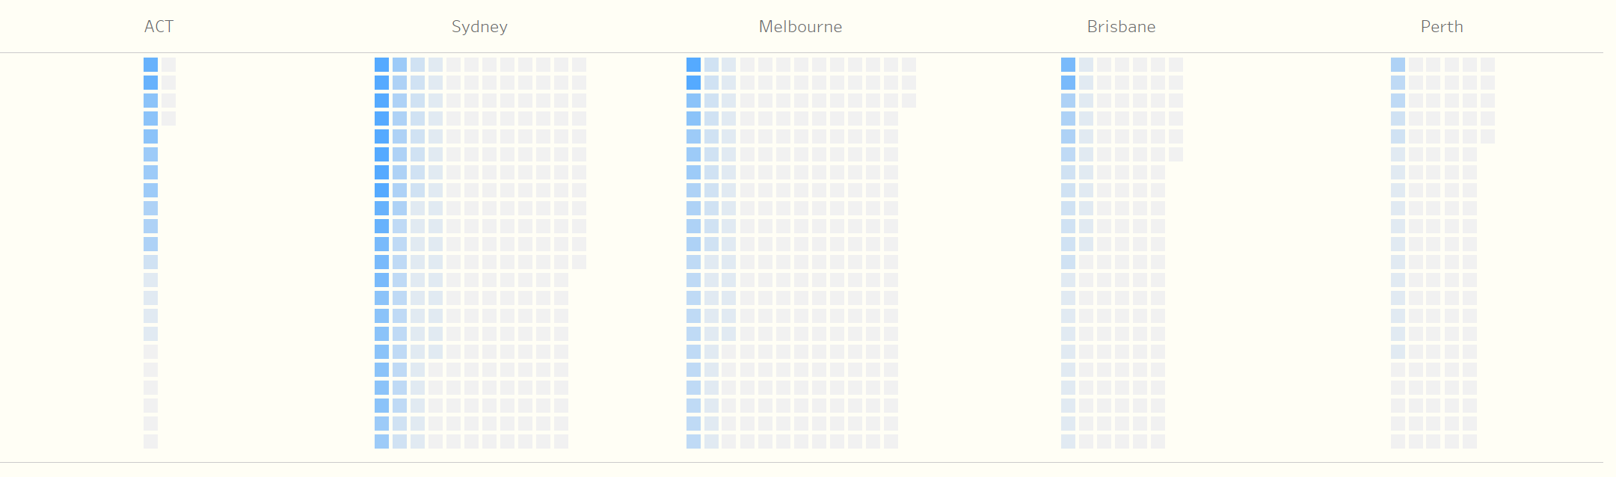
Propensity scoring at postcode level demonstrates the benefits of a targeted approach, particularly in Sydney and Melbourne

Slide 13
Analysis
Within each city, where are the pockets of high propensity?

Slide 14
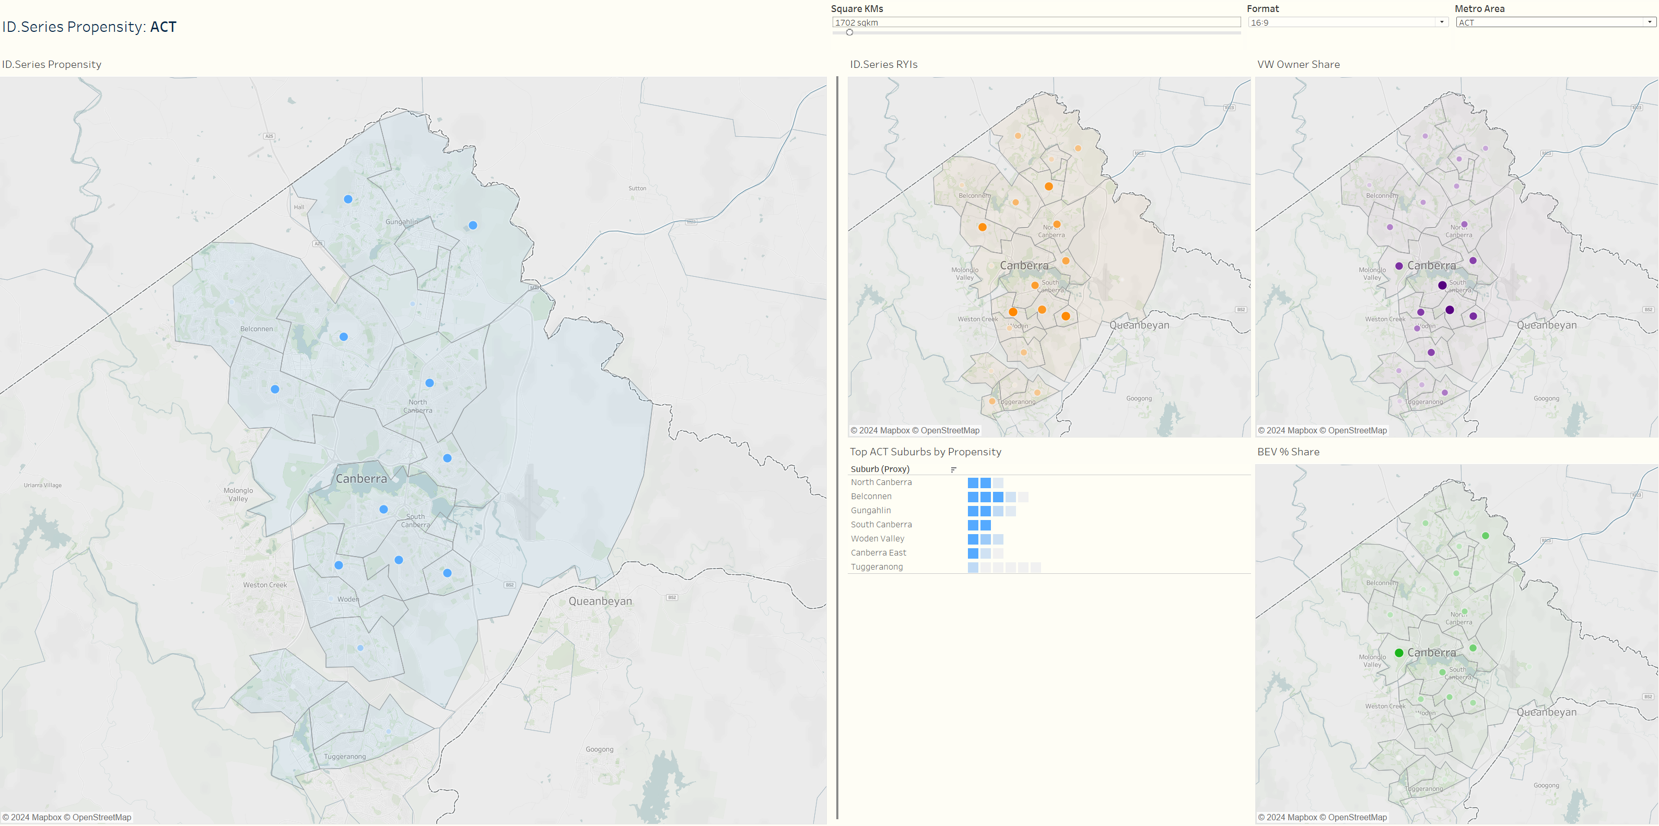
ACT >

Slide 15
ACT: Key Takeaways
Drivers of propensity show different distributions across the ACT:
EV penetration highest in Gunaghlin, East Canberra
VW ownership highest in South Canberra
Results in an even, high propensity distributed right across ACT, and given fewer than 500k vehicles on the road, Canberra represents a cost-effective opportunity market for VW EVs

Slide 16
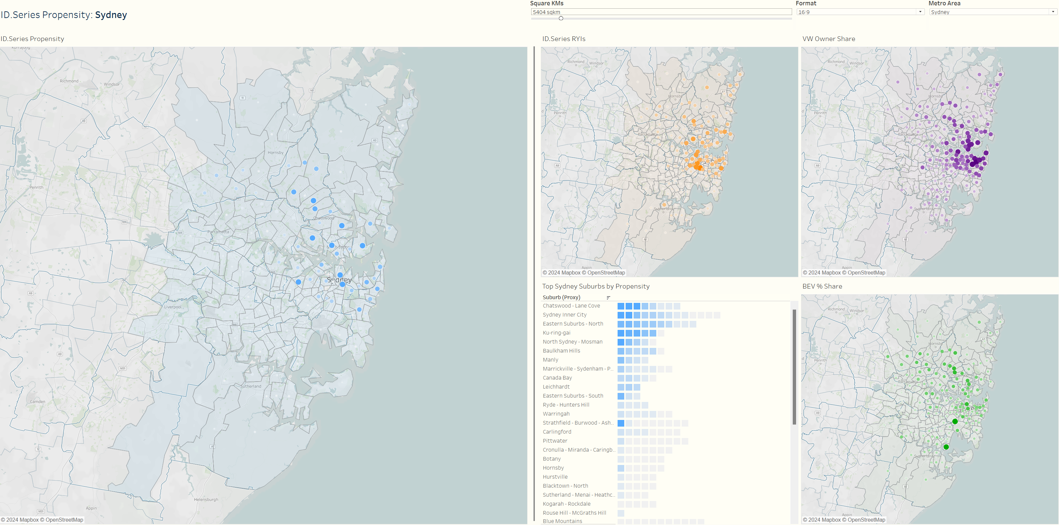
Sydney >

Slide 17
Sydney: Key Takeaways
Highest propensity post codes found in the (North) Eastern Suburbs, the North Shore and the near Inner West
Some suburbs in The Hills and Hornsby had high EV uptake and might also be worth targeting given their relative state of EV readiness
Suggests Northern Beaches, and the Southern and Western regions of Sydney might not be ideal targets for the ID. series.

Slide 18
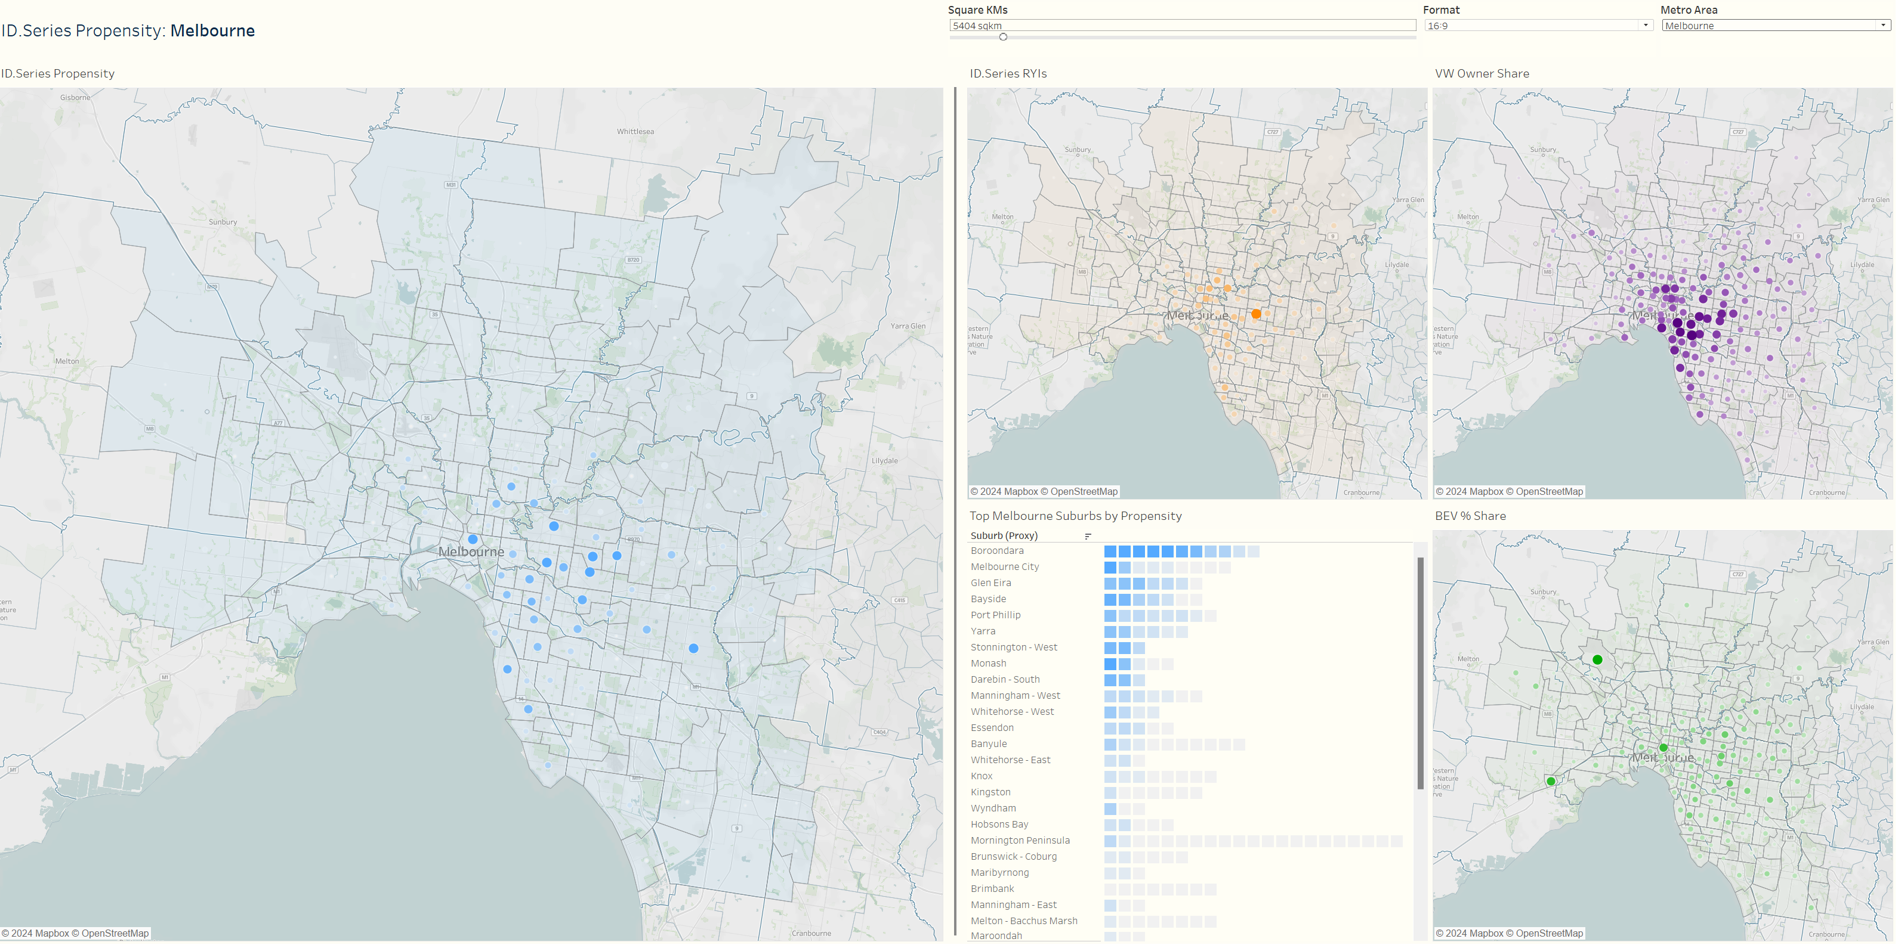
Melbourne >

Slide 19
Melbourne: Key Takeaways
Whilst Melbourne’s average propensity for the ID. series was fairly low, there were hotspots of high propensity worth investing in
Principally, these could be found in the wealthy Eastern suburbs – such as Kew, Hawthorn, Camberwell, Toorak and Brighton
Interestingly the distribution of VW owners and RYIs was very tight within these regions, but EV ownership sprawls more broadly (though still skewing east of the CBD)

Slide 20
Next steps

Slide 21
Opportunities to level up in Phase 2
Based on the Phase 1 methodology:
Consistent, consolidated data on EV ownership (and growth over time)
Mapping VW dealerships to highlight those in suburbs with higher EV propensity
Addition of EV charger locations / density
Sensitivity analysis and weighting of propensity score
Leverage EV Sales data within the group (Audi e-tron, CUPRA Born)
Regain share
Expanding to target audiences through non-geo means:
Develop and investigate audience trends
Understand and incorporate differences between buyers of the four VGA brands
3 phase power / Ampol networks
Dwelling type
Geo one dimension of many (solar chart)
(VW FS and data they’ve got available)
Decannibalise and conquer? Regain superiority?

Slide 22
Recommended target postcodes
Recommended target postcodes:
ACT:
Sydney:
Melbourne:
Postcode | City | Propensity
Tier 1
2045 | Sydney | 100%
2025 | Sydney | 76%
2023 | Sydney | 54%
Tier 2
2045 | Sydney | 100%
2025 | Melbourne | 76%
2023 | Sydney | 54%
Postcodes to target (by tiers)
And what constitutes each tier
Tomorrow

Slide 23
Top postcodes to target beyond top 3 cities (if strategic opportunity arose)
Postcode | Propensity | Tier
Brisbane
2045 | 100%
2025 | 76%
2023 | 54%
Perth
2045 | 100%
2025 | 76%
2023 | 54%
Postcode | Propensity | Tier
Adelaide
2045 | 100%
2025 | 76%
2023 | 54%
Gold Coast
2045 | 100%
2025 | 76%
2023 | 54%
Postcode | Propensity | Tier
Hobart
2045 | 100%
2025 | 76%
2023 | 54%
Sunshine Coast
2045 | 100%
2025 | 76%
2023 | 54%
Postcodes to target (by tiers)
And what constitutes each tier
Tomorrow

Slide 24
Appendices
METRO AREA DASHBOARDS

Slide 25
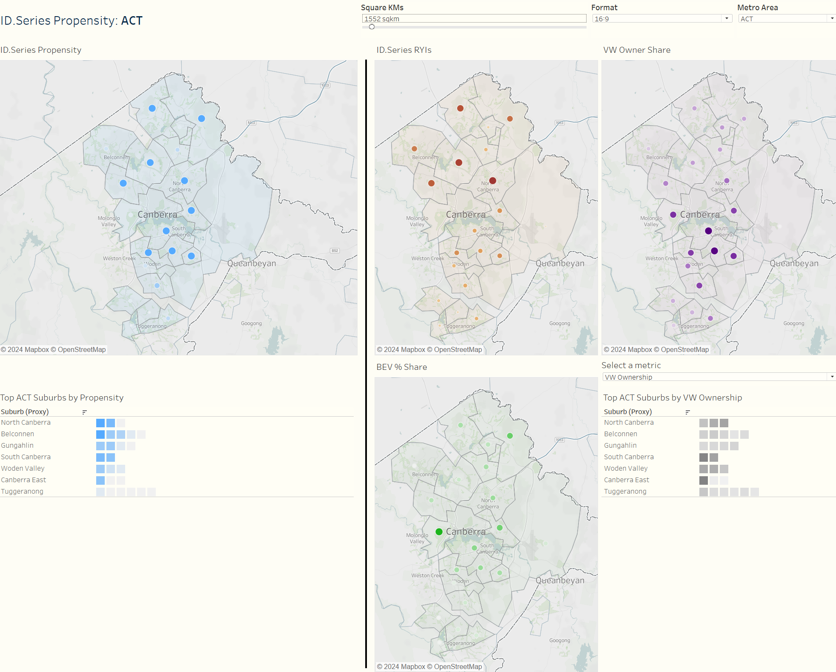
ACT
All scales represent positive relationship between size/color intensity and metric. For individual metro areas, scales are relative to other suburbs in the same metro area only

Slide 26
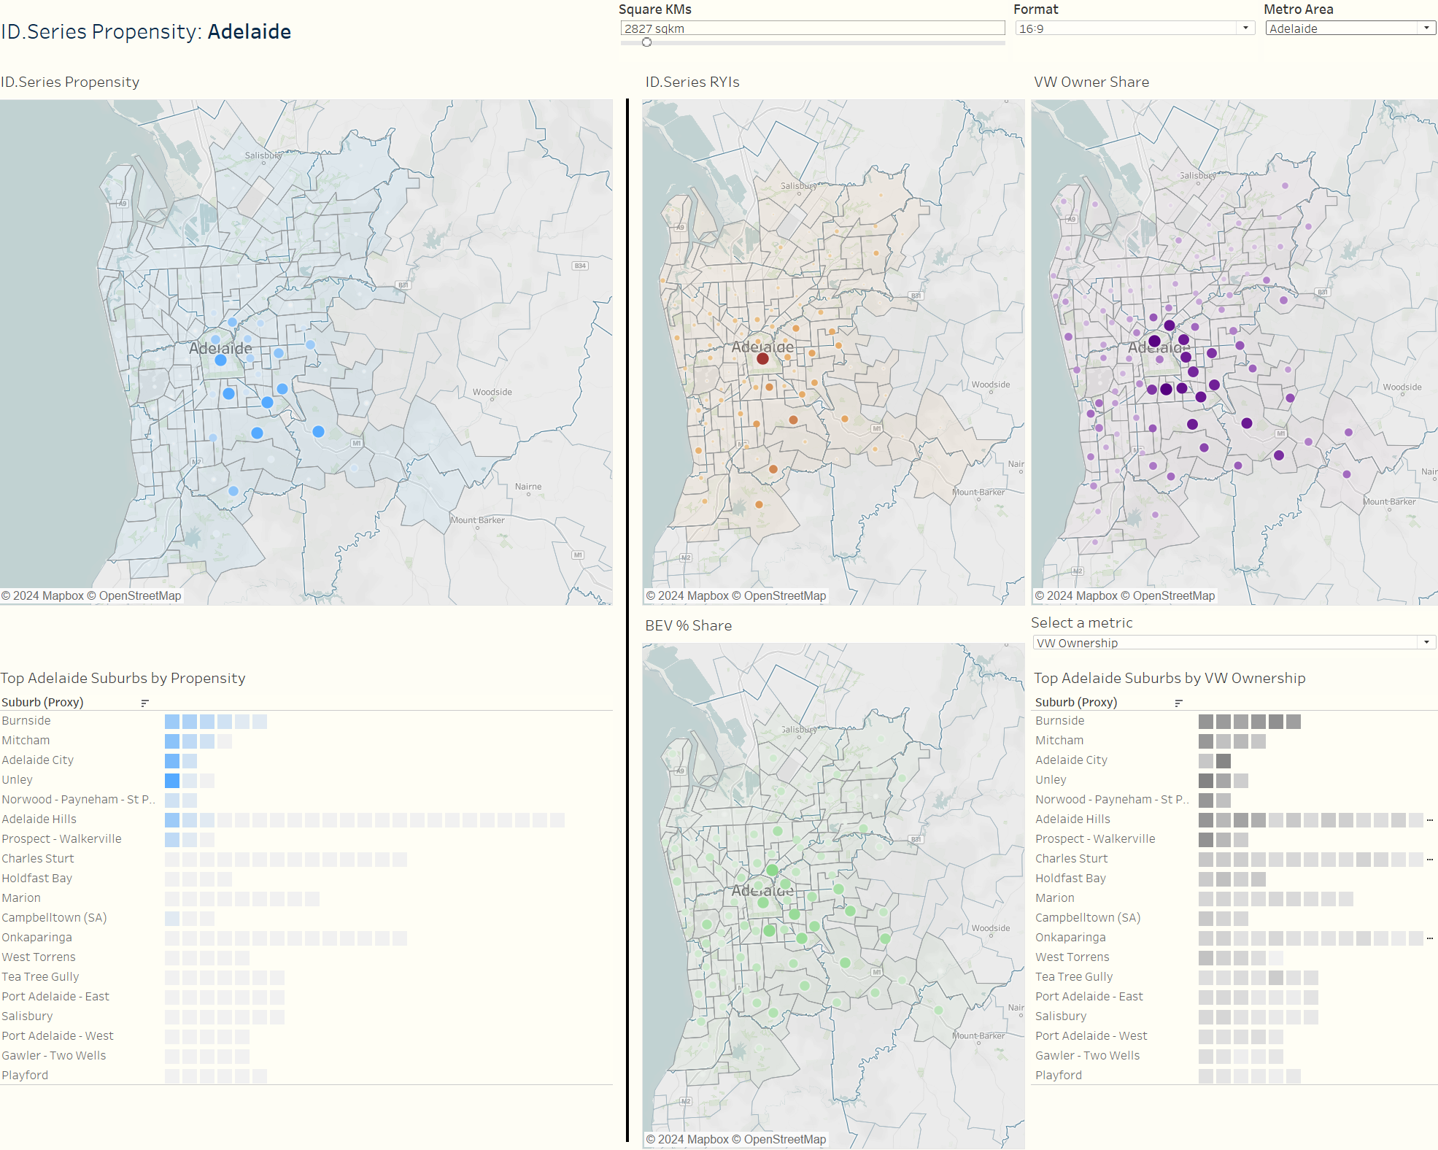
Adelaide

Slide 27
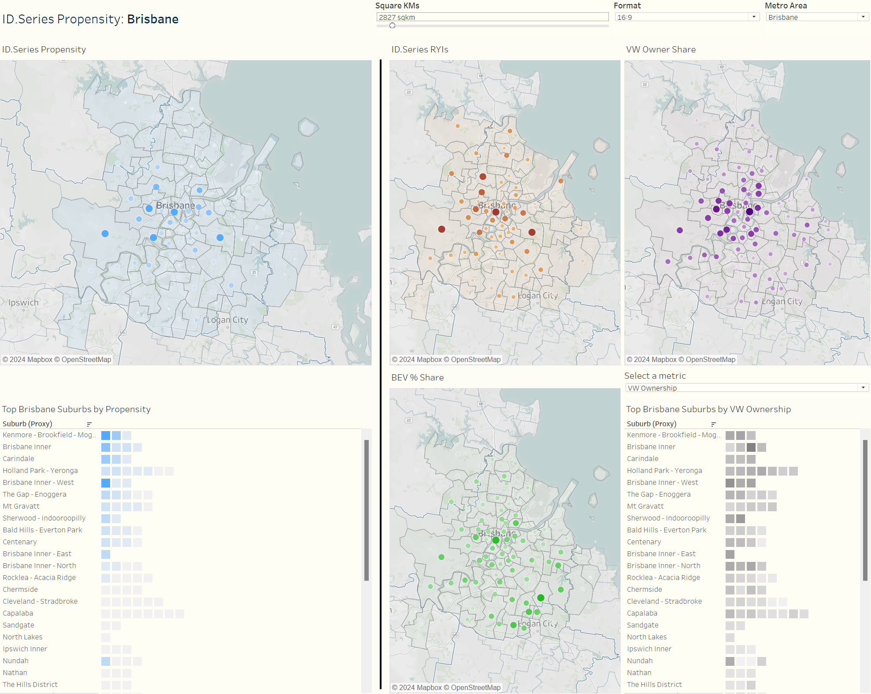
Brisbane

Slide 28
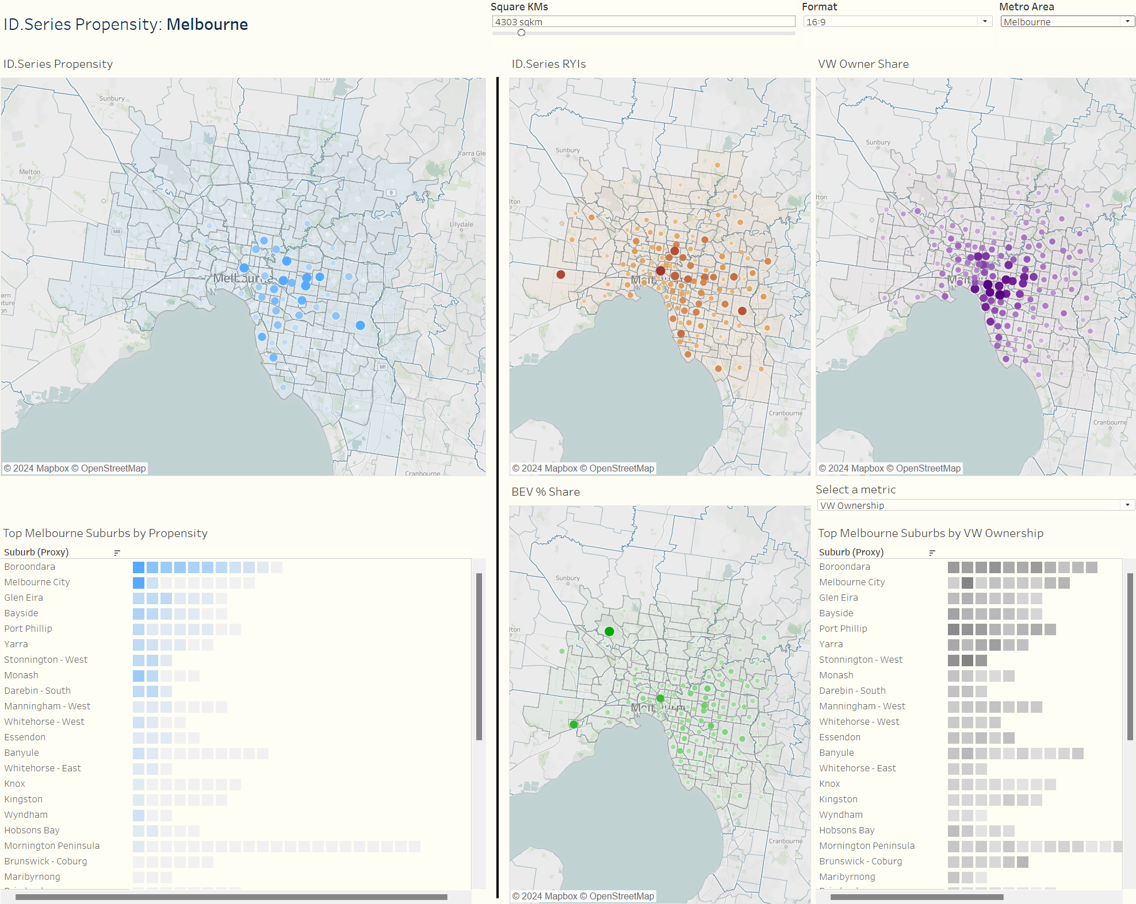
Melbourne

Slide 29
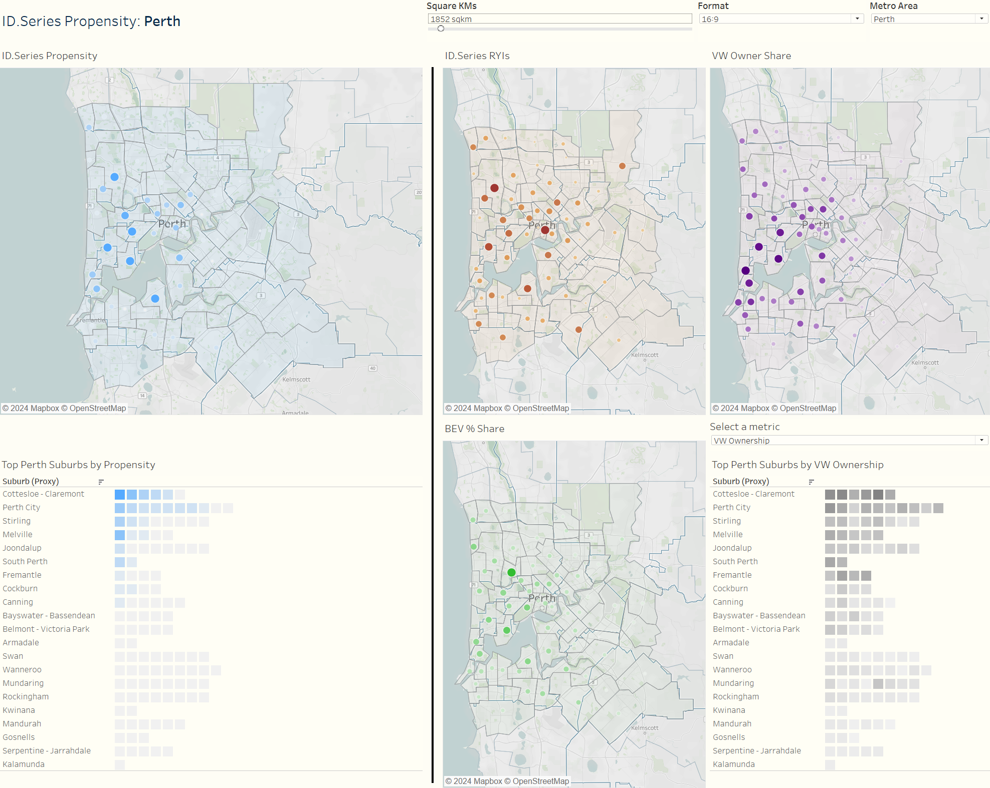
Perth

Slide 30
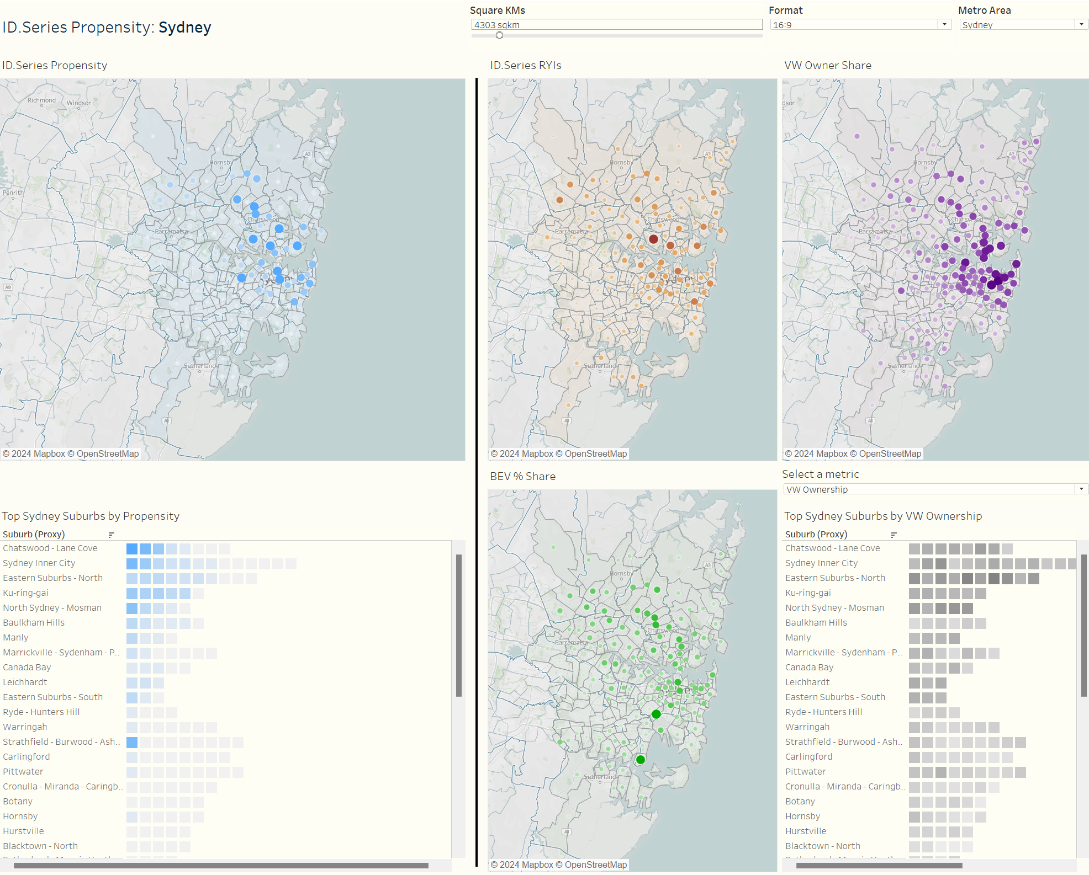
Sydney

Slide 31
Appendices
DOCUMENTATION

Slide 32
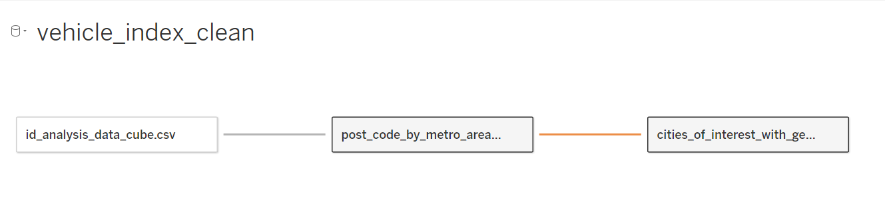
Our Data Structure
The final data structure in Tableau consists of three files:
TABLE | DETAIL
Primary data cube | At postcode, fueltype, year level: Light vehicles (LVs) VW ownerships ID.4 and ID.5 RYIs Note that only LVs data exists at fueltype and year level
Geography lookup | Helps us match postcodes to suburbs (note the cardinality of this relationship is many to many – a postcode can intersect multiple suburbs, and vice-versa)
City of interest lookup | Used for identifying centroids of different metropolitan areas
32

Slide 33
Graveyard
DOCUMENTATION

Slide 34

In October, Volkswagen will launch its first electric vehicles in Australia - the ID.4 and ID.5 aiming to sell over 4,000 EVs. This is an ambitious target, particularly given market share for passenger vehicles, as well as competing against more established EV brands and aggressively-priced Chinese brands. With high spending competitors, we know we need to play a very smart game to punch above our weight.
34

Slide 35
Our Approach
Focused targeted campaign finding audiences with a higher propensity to VW ID.4 and ID.5, rather than spreading our spend across national activity.
Our early hypothesis: there is a significant overlap between postcodes over-indexing for EV sales, and those historically predisposed to Volkswagen. We see an opportunity to present VW as the EU brand without the sticker shock for those ‘trading down’.
35

Slide 36
Research Task
Based on available data available (listed over), we want to develop a clear point of view as to whether:
There are one or more environments (either physical or digital) in which those predisposed to purchase both electric vehicles and Volkswagen overlap
These environments could likely sustain > 4,000 vehicle sales in 6 months (either in isolation or combination), utilizing newly released EV Council sales data
Develop a series of hypotheses to target high propensity audiences to VW ID. Series
Phase
one
Phase
two
36

Slide 37
Phase one: tasks
Initial analysis of latest EV council data
Refresh VW data extracts from SFMC (VW ownership and RYIs)
ETL into existing proof of concept underlying data cube
Update the dashboards and creation of visualisation for each state capital
Preparation of PDF outputs
Overlay commentary/recommendations
37

Slide 38
Phase one: outputs
PDF outputs of the Tableau dashboard including:
Visualisation of each state capital at the post code level for each metric contributing to the propensity metric
The propensity metric
A list of the top suburbs and their propensity scores in excel
Annotated commentary and recommendations by strategy
Investment: $12,144
38

Slide 39
Phase two: objectives
The goal of this phase is to leverage first (owned), second (partner-collected) and third (market level / paid-for) party data sources to:
Identify different target audiences with high propensity towards the Volkswagen ID Series; and
Inform more precise content and channel strategies for those target audiences
Investment: TBC
39

Slide 40
Research tasks
Hypothesis Development Workshop
Gather and expand upon existing hypotheses to identify VW EV purchasers.
Discuss and prioritise hypotheses based on (1) perceived signal strength for ID Series propensity; (2) feasibility of using for targeting
Discuss initial routes to validating priority hypotheses with data.
Output :
3-5 preferred hypotheses to pursue on how we might distinguish high propensity VW ID. Series buyers.
Initial example hypothesis:
“Premium / luxury vehicle owners may be more likely to consider VW EVs for a second vehicle in the current economic environment”
40

Slide 41
Research tasks
Validation
Data discovery and analysis to reinforce hypotheses with data. Examine existing VW data sources (ARC, VW CRM, etc) and market research to support validation of existing hypotheses.
RAPP would also surface any ancillary findings resulting from its review of these data sources.
This stage may result in rejection of some hypotheses either due to data suggesting a different result, or lack of data to support.
Output :
Where possible, data visualisations demonstrating the validity of each priority hypothesis.
41

Slide 42
Research tasks
Audience Accessibility
In collaboration with PHD, working sessions to develop a targeting methodology for each of our validated audiences, understanding and experimenting with the signals included in our audience definition to optimise size / cost of each audience.
Output :
For each audience, an assessment of buyability across:
Size
Cost (if possible)
Means of targeting (channel, signals)
42

Slide 43
Phase two outputs
Strategy Development
Combine target audiences from phases 1 and 2, with hygiene factors such as targeting audiences based on recent interest in EVs, retargeting RYIs and lookalike modelling into one coherent audience strategy.
Development of a supporting measurement framework detailing KPIs for activity by channel,
and support for in-flight optimisation of audience targeting budgets.
Output :
Strategy document outlining audience strategy for ID. Series launch:
Audience definition, targeting criteria, channel(s), content / messaging, initial spend
43

Slide 44
Timings
w/c 15 Apr | w/c 22 Apr | w/c 29 Apr | w/c 6 May | w/c 13 May
Chris A/L
Phase one
Phase one findings presented
Approach presented
VW
Approval
Phase two scoping
Phase two SOW presented
Phase two ideation workshop
44

Slide 45
Next steps
Begin scoping phase two – w/c 15 Apr
VW approve scope for phase one – Wed 17 Apr
Kick off phase one – Mon 29 Apr
Provide scope of work for phase two - Fri 19 Apr
45

Slide 46

Thanks
46

